Slide 1




Data Science Salaries Classification (2023)
×
By: Muhammad Yusuf Royhan
Portfolio - Project Digital Skill Fair 35.0 Data Science

Slide 2



MUHAMMAD YUSUF ROYHAN
I am an Electrical Engineering graduate from Cendekia Abditama University, with strong analytical skills in data processing. Currently, I am ambitious to develop my potential and switch my career to the field of Data Science, specifically as a Data Analyst, Data Scientist, or Data Engineer.
I have skills that support this transition, including mastery of Microsoft Office, Python, Power BI, Tableau, Google Colab, and SQL. These skills enable me to effectively analyse and visualise data, as well as provide reliable insights for data-driven decision-making.
With a solid technical background and a deep interest in data science, I am ready to contribute significantly to a dynamic team. I believe that the combination of my education, analytical skills, and desire for continuous learning will make me a valuable asset to the organisation I join. I am highly motivated to collaborate on challenging projects and provide innovative solutions to challenges in the data world.

Slide 3



INTRODUCTION!
DATASET FROM KAGGLE = Data-Science-Salaries-Classification-2023
The ‘Data Science Salaries Classification 2023’ dataset available on Kaggle contains information about the salaries received by data science and analytics professionals in 2023. The main purpose of this dataset is to provide insight into the salaries offered to workers across different positions, experience levels, locations, and company types.
This dataset is presented in CSV format and consists of several columns, including years of employment, experience level (such as Senior, Mid-level, Entry-level, and Executive), job type (Full-time, Contract, Freelance), specific job title (such as Data Scientist, Machine Learning Engineer, and Data Analyst), as well as information on salary in local currency and US dollars.
📊 Initial Dataset Exploration Results
Data count: 3.755 rows, 11 columns
Data type:
4 numeric columns (work_year, salary, salary_in_usd, remote_ratio)
7 category columns (experience_level, employment_type, job_title, salary_currency, employee_residence, company_ location, company_size)
No missing values 🎉
Salary in USD (salary_in_usd) has a large range, from $5,132 to $450,000 with Salary Classification (Low, Medium, High).

Slide 4
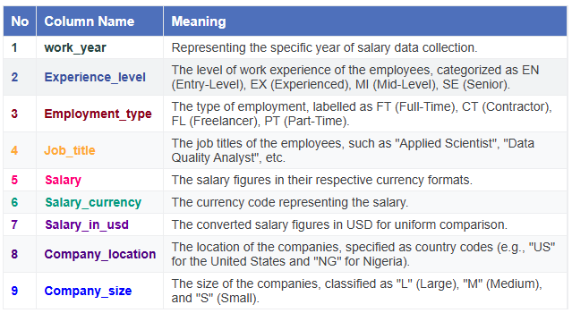
DATA DESCRIPTION!
DATASET FROM KAGGLE = Data-Science-Salaries-Classification-2023

Slide 5








TOOLS USED

Slide 6


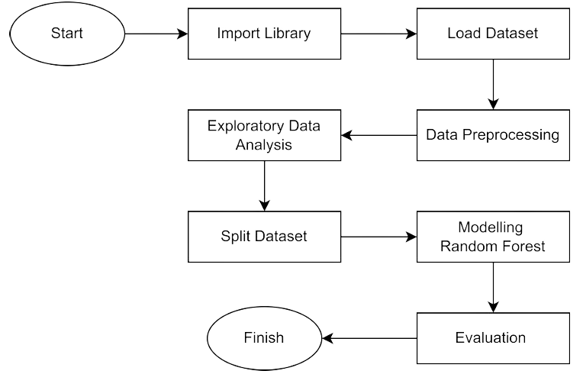


FLOWCHART!

Slide 7
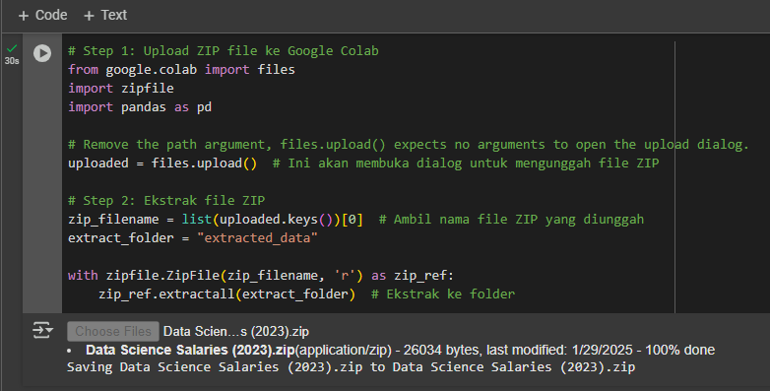
UPLOAD & EKSTRAK FILE ZIP TO GOOGLE COLAB

Slide 8
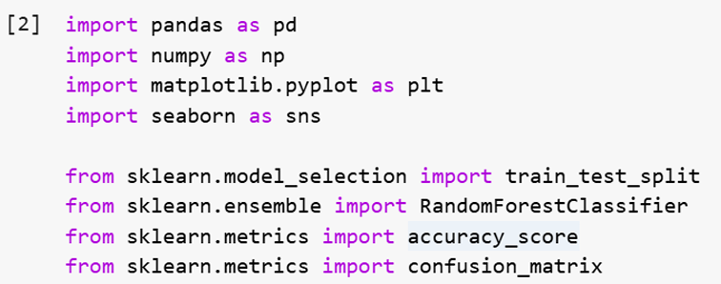

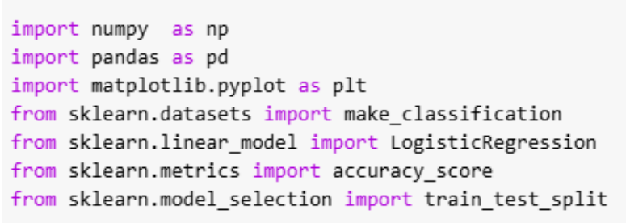


IMPORTING LIBRARIES! 📚
Alongside these are some of the Python libraries that we used to build our salary classification model for data science.

Slide 9
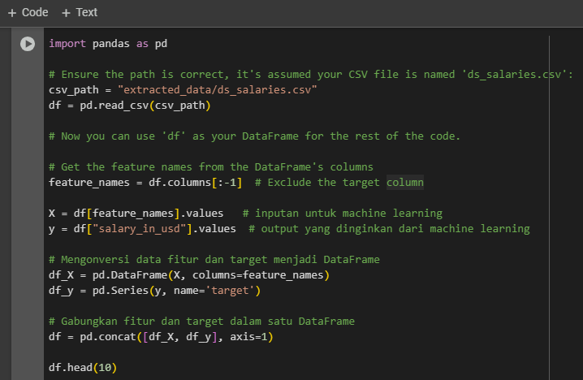

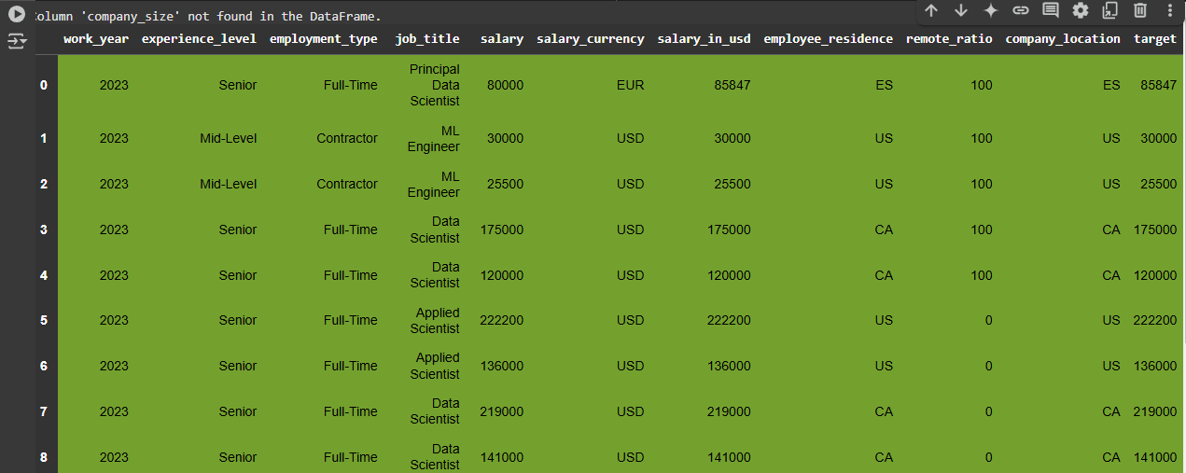
LOAD DATASET! - EXPLORATORY DATA ANALYSIS ✨
In this Data Science Salaries there are several Input Variables, I took only 10 rows from the feature and target data that has been merged into the DataFrame

Slide 10
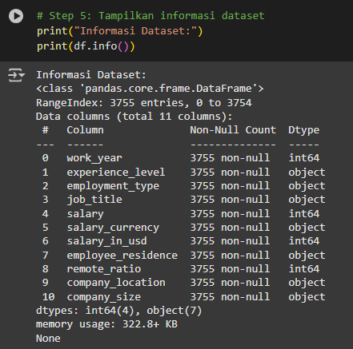
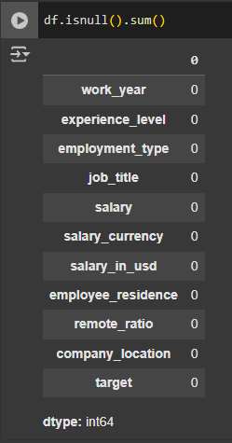
EXPLORATORY DATA ANALYSIS (EDA) ✨
SOME INFORMATION 🗂
CHECK MISSING VALUES 🗂

Slide 11
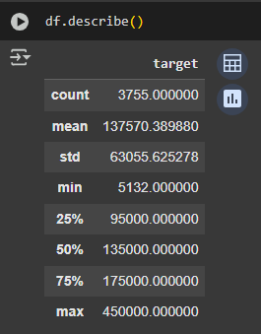
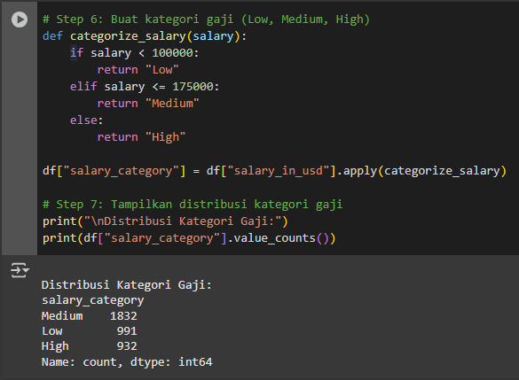
EXPLORATORY DATA ANALYSIS (EDA) ✨
STATISTIC 🗂
SALARY 🗂

Slide 12
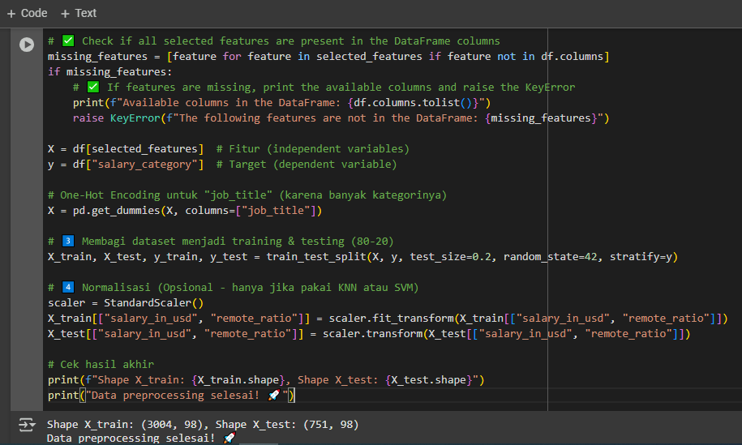
DATA PREPROCESSING ✨

Slide 13
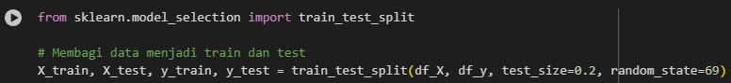
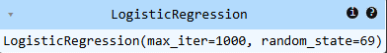
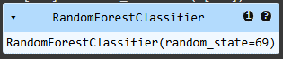
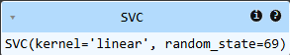
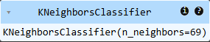
SPLIT DATA & TRAIN THE MODEL ✨
MODEL LOGISTIC REGRESSION
MODEL RANDOM FOREST
MODEL SVC
MODEL KNN

Slide 14

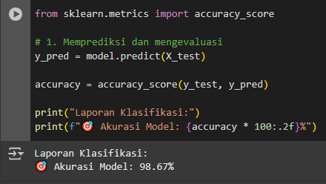
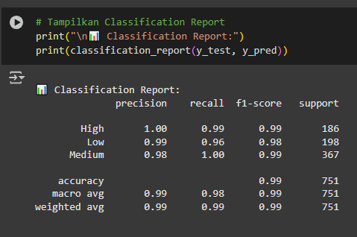

PREDICT & EVALUATION ✨
MODEL ACCURACY 😊
CLASSIFICATION REPORT 😊

Slide 15
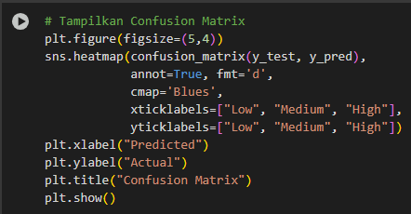
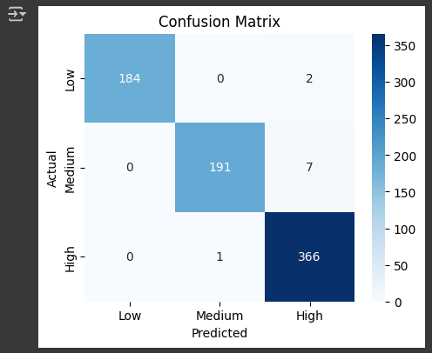


CONFUSION MATRIX ✨

Slide 16
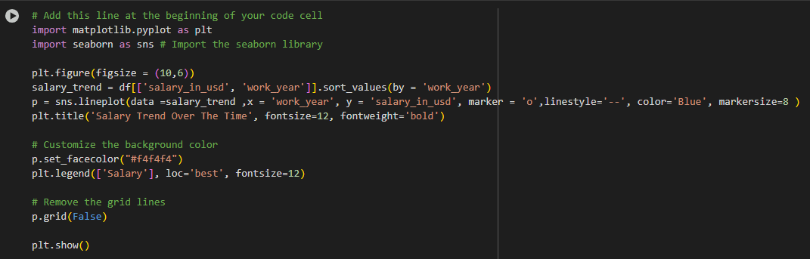
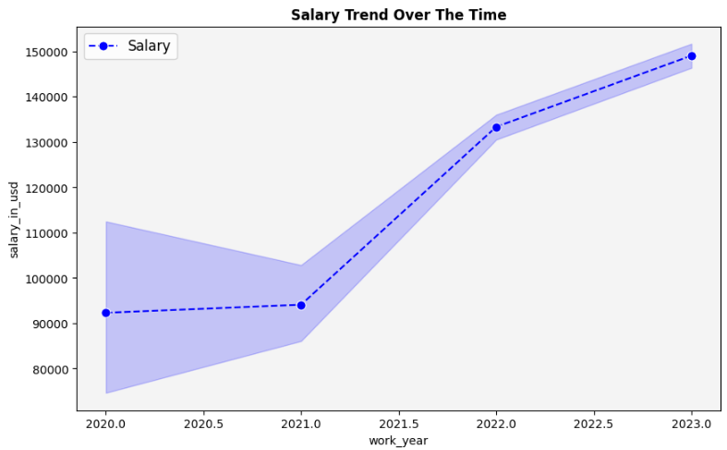


DATA SCIENCE SALARY TRENDS 📅

Slide 17

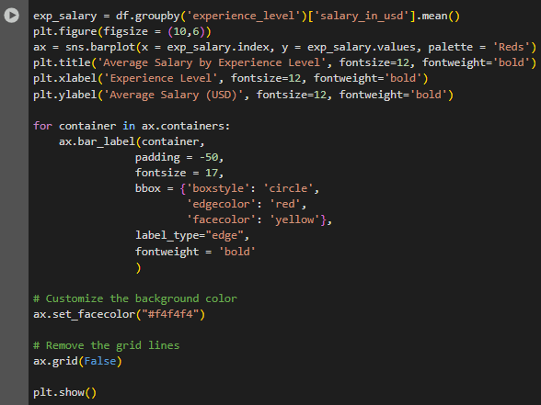
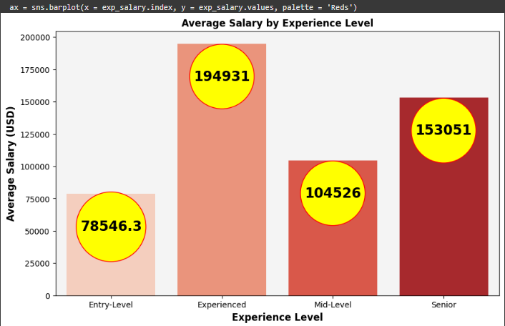
AVERAGE SALARY BY EXPERIENCE LEVEL 📊

Slide 18
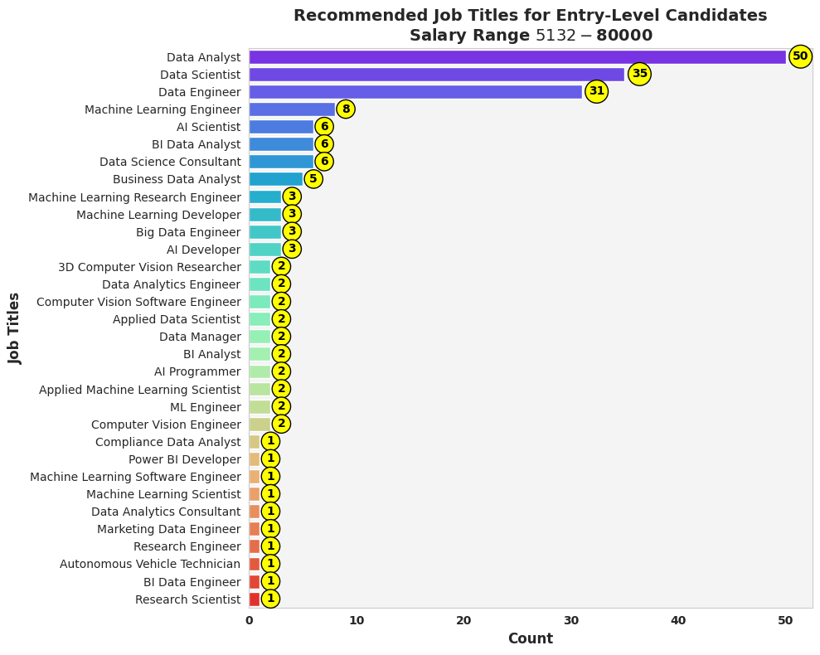



JOB TITLE RECOMMENDATION 💼

Slide 19

CONCLUSION!
The ‘Data Science Salaries Classification 2023’ project demonstrates that analysing salaries in the field of data science requires a systematic and data-driven approach. Through the exploration of a dataset covering 3,755 rows and 11 columns, we were able to identify significant patterns in salaries based on experience level, job title, location, and company type. Using modelling techniques such as Logistic Regression, Random Forest, SVC, and KNN, we were able to classify salaries into low, medium, and high categories with satisfactory accuracy.
The results of this analysis provide valuable insights for professionals looking to pursue a career in data science, as well as for companies looking to establish a competitive salary structure. The combination of solid technical expertise and a deep understanding of salary dynamics will facilitate better decision-making in the future. This project proves that data is not just a number, but also a source of information that can drive innovation and development in the data science industry.
LINK KODINGAN!

Slide 20







THANK YOU!

